Slide 1
Year 11 – The road ahead
Year 11 – The Road Ahead!
Thursday 15th June

Slide 2
Questions for the school

Slide 3
What are the Dates of mocks, GCSE exams and results please?
6th November – Mock Exams start (set 1)
17th November – Mock Exams end (set 1)
19th December – Mock Exam Results Day
19th February – Mock Exams start (set 2)
1st March –Mock Exams end (set 2)
May-June – GCSE Exams
22nd August – GCSE Results

Slide 4
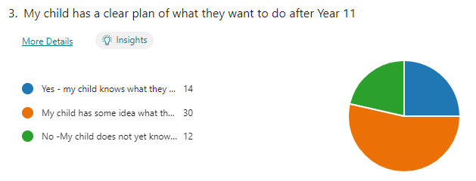
Survey Results
Does your child know what they want to do after next year?

Slide 5
My child is really struggling with what she wants to do in the future and needs to visit more colleges, What college open events are available?
Year 10 have a visit to cronton college, Priestly and warrington vale this term
All colleges hold open evenings in the autumn term – we suggest going to all
All students are helped to apply to three colleges before Christmas
All students have a 1-1 meeting with paula our careers link advisor

Slide 6
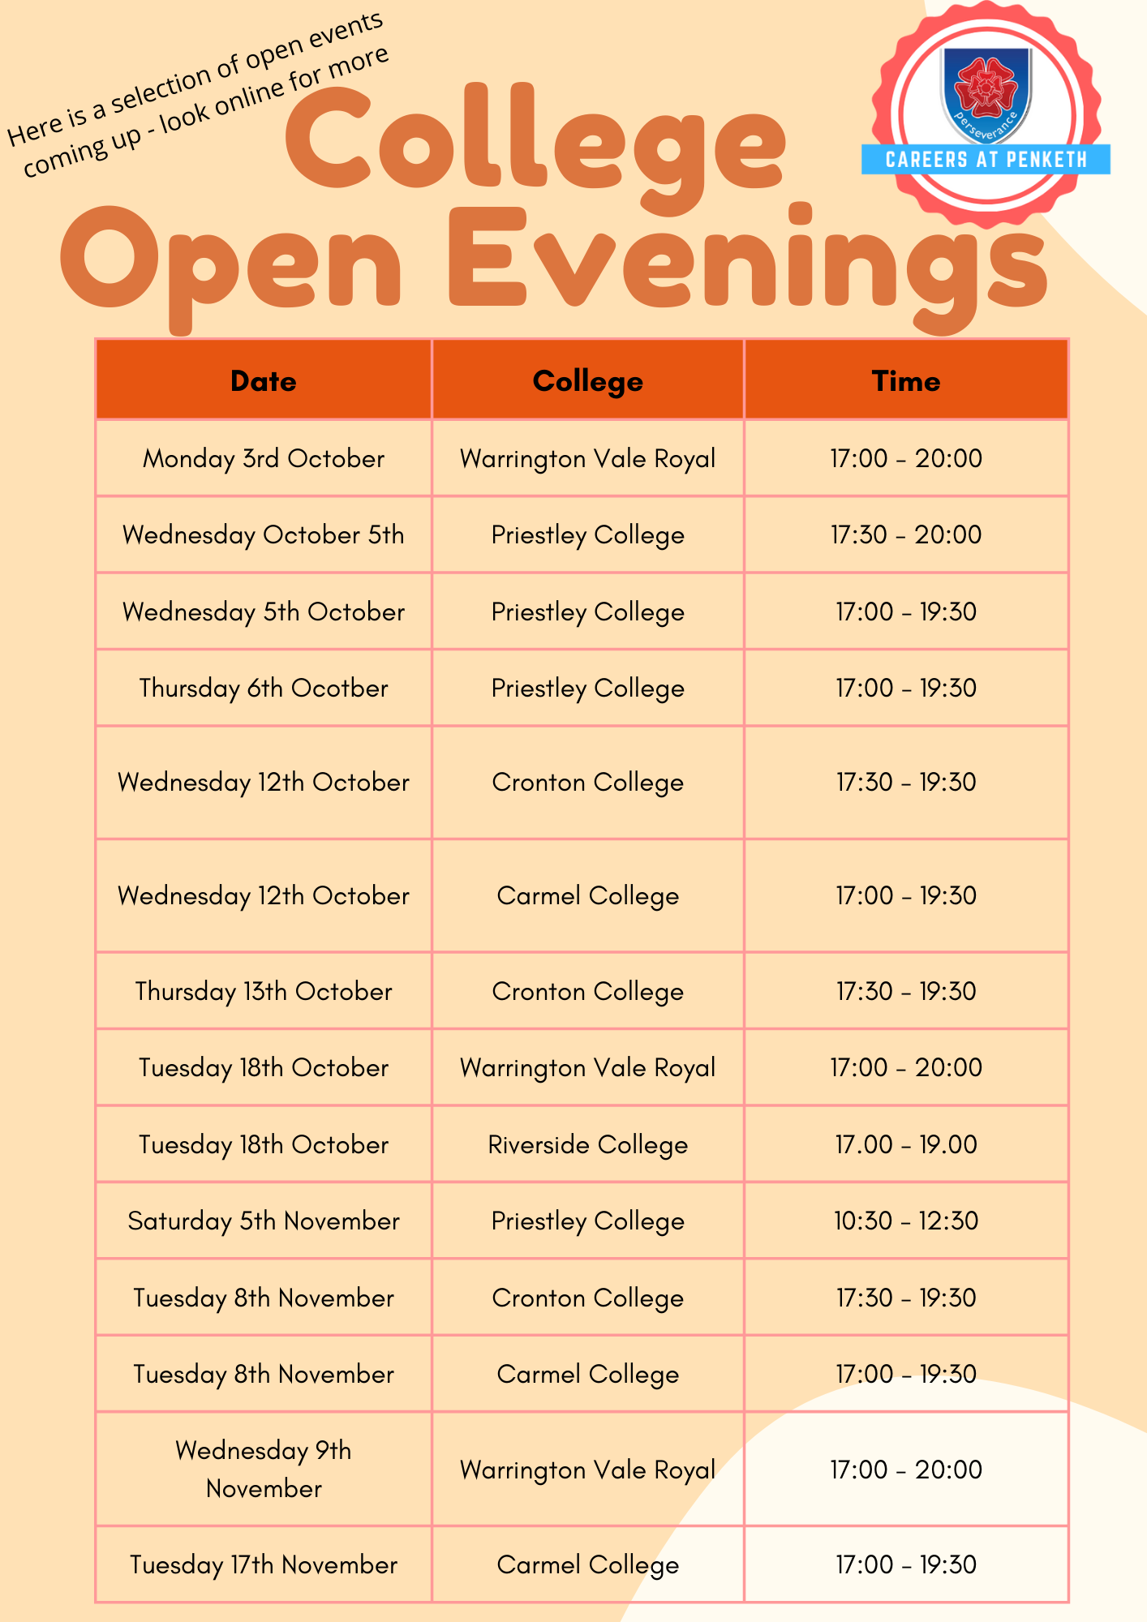
THIS INFORMATION WAS FOR CURRENT YEAR 11’S – THESE DATES ARE NOT ACCURATE FOR 2023/24!

Slide 7
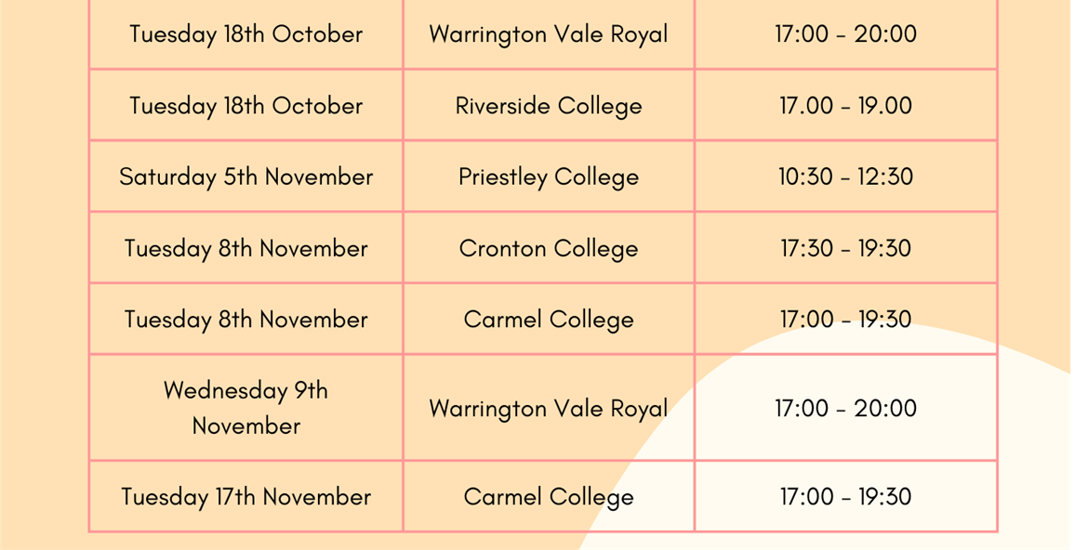

Slide 8
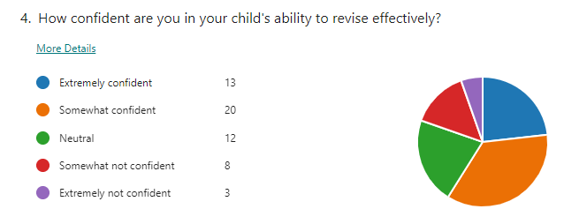
Survey Results
How confident are you in your child’s ability to revise effectively?

Slide 9
How much enrichment time can Be spent revising! The more they can do before leaving the school building the better.
Year 11 do not have enrichment – period 6 mon-thurs are EPS timetabled revision sessions in departments
Revision room available every night for independent study
External tuition available from October mon-thurs 3:15-4:15

Slide 10
STUDENT | HOURS | PROM
STUDENT 1 | 145 | £43.50
STUDENT 2 | 88 | £26.40
STUDENT 3 | 86 | £25.80
STUDENT 4 | 77 | £23.10
STUDENT 5 | 74 | £22.20
STUDENT 6 | 73 | £21.90
STUDENT 7 | 73 | £21.90
STUDENT 8 | 68 | £20.40
STUDENT 9 | 67 | £20.10
STUDENT 10 | 57 | £17.10
STUDENT 11 | 56 | £16.80
STUDENT 12 | 56 | £16.80
STUDENT 13 | 52 | £15.60
STUDENT 14 | 51 | £15.30
STUDENT 15 | 50 | £15.00
STUDENT 16 | 47 | £14.10
STUDENT 17 | 46 | £13.80
STUDENT 18 | 46 | £13.80
STUDENT 19 | 45 | £13.50
STUDENT 20 | 45 | £13.50
STUDENT 21 | 44 | £13.20
STUDENT 22 | 43 | £12.90
STUDENT 23 | 42 | £12.60
STUDENT 24 | 40 | £12.00
STUDENT 25 | 40 | £12.00

Slide 11
Student | Av Grade | ENGLISH | MATHS | EBACC | OPEN
STUDENT 1 | 3.1 | 2.88 | 1.94 | 2.52 | 4.20
STUDENT 2 | 2.89 | 1.78 | 1.89 | 2.67 | 4.12
STUDENT 3 | 2.25 | 1.93 | 1.95 | 1.27 | 3.47
STUDENT 4 | 2.2 | 1.99 | 2.98 | 0.65 | 3.37
STUDENT 5 | 1.9 | 0.94 | 2.95 | 0.61 | 2.99
STUDENT 6 | 1.9 | 0.94 | 2.95 | 0.61 | 2.99
STUDENT 7 | 2.15 | 2.94 | 0.95 | 1.60 | 2.82
STUDENT 8 | 1.95 | 1.94 | 1.95 | 1.10 | 2.65
STUDENT 9 | 1.6 | 0.93 | 0.95 | 1.27 | 2.64
STUDENT 10 | 1.3 | -0.05 | 1.93 | 0.61 | 2.32
STUDENT 11 | 1.2 | 0.91 | -0.07 | 0.91 | 2.28
STUDENT 12 | 1.78 | 1.96 | 1.96 | 0.97 | 2.26
STUDENT 13 | 1.85 | 1.95 | 2.93 | 0.61 | 2.15
STUDENT 14 | 1.5 | 0.96 | 1.96 | 0.96 | 2.00
STUDENT 15 | 1.55 | 1.00 | 2.00 | 1.33 | 1.89
STUDENT 16 | 1.7 | 1.96 | 1.96 | 1.29 | 1.67
STUDENT 17 | 1.49 | 1.033 | 2.285 | 0.914 | 1.626

Slide 12
How often they should be studying?
As a general rule of thumb we advise the following
Mon-fri 2 x 45 minute sessions per night
Sat-sun 3 x 45 minute sessions per day
Homework does count in these timings

Slide 13
Will they be given lists of the topics they need to revise for each subject?
Yes – before mock exams in November and march
However – it is important that students realise that these are not available for gcse exams in the summer

Slide 14
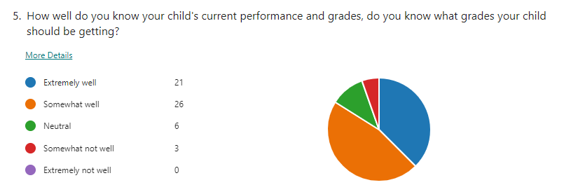
Survey Results
Do you know your child’s current grades and what they should be getting?

Slide 15
Arbor app – click on reports

Slide 16
SUBJECT | MINIMUM EXPECTED GRADE
BIOLOGY | 8
CHEMISTRY | 8
ECONOMICS | 7
ENGLISH LANGUAGE | 7
ENGLISH LITERATURE | 7
FRENCH | 7
HISTORY | 8
MATHS | 8
PHYSICS | 8

Slide 17
SUBJECT | DECEMBER GRADE | MINIMUM EXPECTED GRADE
BIOLOGY | 5 | 8
CHEMISTRY | 5 | 8
ECONOMICS | 4 | 7
ENGLISH LANGUAGE | 7 | 7
ENGLISH LITERATURE | 6 | 7
FRENCH | 4 | 7
HISTORY | 7 | 8
MATHS | 7 | 8
PHYSICS | 4 | 8

Slide 18
SUBJECT | MARCH GRADE | MINIMUM EXPECTED GRADE
BIOLOGY | 6 | 8
CHEMISTRY | 5 | 8
ECONOMICS | 5 | 7
ENGLISH LANGUAGE | 7 | 7
ENGLISH LITERATURE | 5 | 7
FRENCH | 5 | 7
HISTORY | 7 | 8
MATHS | 9 | 8
PHYSICS | 4 | 8

Slide 19
SUBJECT | MINIMUM EXPECTED GRADE
BUSINESS | L2 MERIT
DT | L2 MERIT
ENGLISH LANGUAGE | 4
ENGLISH LITERATURE | 4
FRENCH | 4
GEOGRAPHY | 4
MATHS | 4
SCIENCE* | 4-4*

Slide 20
SUBJECT | DECEMBER GRADE | MINIMUM EXPECTED GRADE
BUSINESS | L1 PASS | L2 MERIT
DT | L1 MERIT | L2 MERIT
ENGLISH LANGUAGE | 2 | 4
ENGLISH LITERATURE | 2 | 4
FRENCH | U | 4
GEOGRAPHY | 2 | 4
MATHS | 1 | 4
SCIENCE* | 2-1 | 4-4*

Slide 21
SUBJECT | DECEMBER GRADE | MINIMUM EXPECTED GRADE
BUSINESS | L1 MERIT | L2 MERIT
DT | L2 PASS | L2 MERIT
ENGLISH LANGUAGE | 2 | 4
ENGLISH LITERATURE | 2 | 4
FRENCH | 2 | 4
GEOGRAPHY | 2 | 4
MATHS | 1 | 4
SCIENCE* | 3-2 | 4-4*

Slide 22
What’s the process for additional support in the lessons where students are not at grade 4?
After each exam series (including year 10) I look at each students grade in each subject to identify underperformance – this information will be shared with departments, students and parents
This is not just for students not on track to get a ‘4’ but for all students who look like they might not hit their meg targets
Tuition is available and will start in october

Slide 23
how do you support children with SEN/MH with the pressures of GCSEs and revising.
Students with sen needs perform very well typically. Last year students with an ehcp had a progress 8 score of -0.08 (0 is expected progress)
Students with semh needs are supported in school by the safeguarding team, semh lead, year 11 academic mentor and the sen team. Students with semh needs or mental health issues performed well last year if their attendance was above 90%

Slide 24
Can you get GCSE results by email? We are on holiday at the time of the results so cannot attend the school & if posted, we won't receive them until we return.
Many families are often on holiday for results day don’t worry
You must write in to school and nominate someone to collect the results on the day (family member, friend, other student etc) who can then share the results with you immediately
This person must bring photo ID on the day of collection

Slide 25
Do the children get support with next steps after school? what help/ support is offered if the child has no idea on what to do after leaving school? If the child isn’t meeting their expected grades by year 11 - what is put in place to get them on track? It would be really helpful If teachers could send out a list of revision guides to buy for each subject? Should they be revising each night after school, or just weekends? what’s the recommended amount of time they should spend revising over the week?

Slide 26
Questions to parents

Slide 27
I would ask them about the stress that was caused by GCSE to their children.
YOU KNOW YOUR CHILD BETTER THAN ANYBODY, KEEP A CLOSE EYE ON THEM. Remember a little stress is a good thing, it keeps us sharp. Too much can be a real problem, watch out for them withdrawing or snapping at things they wouldn’t normally
Be ready for them to come home and sleep!! My lad comes in, snores in the front room, has tea then does some work later
Make sure you keep in touch with school, I spoke with mr farrar several times this year about this very issue and he always managed to help calm my daughter down and offer advice. (he said exactly what I was saying but she actually listened to him!!)

Slide 28
What is your advice when your child seems like they are going to combust with the determination of revising to the point you know they aren't really taking anything in due to the flustered state they present
This could be me asking this question! This literally happened in our house from September to December. I came in and had a meeting with mr farrar and my daughter. He put a plan in place and instead of timing revision we changed her study plan to tasks rather than times. This really helped. She did 2 tasks a night and cut down her time but probably made her more productive.

Slide 29
Are there any particular resources that are more helpful or definite don’t gets? have you used external tutors and do you feel this has helped or complicated things?
Pre-made flashcards were useful, look on amazon!
I found that the revision books you write in were mostly left untouched – the study guides were better in my opinion
I can’t recommend external tutors enough, the change in his maths since January has been amazing. No teacher can give 1-1 for an hour no matter how great they are. It was the boost in confidence that has made the most difference

Slide 30
Did your children feel more pressure for the real exam compared to GCSE?
Nobody answered this question so I asked some students today
I definitely feel more pressure because I know these are the real ones so I have a lot riding on them
Not much more, we do proper exams twice in the year and to be honest I though the mocks were harder than these real ones!
I’ve felt a lot of pressure all year to be honest – but we all know we can talk to the teachers and they are great at helping and making you calm.

Slide 31
How do you best support children at home with revision, particularly if the child is disengaged with it.
Do not battle!!!! I’ve done this twice now and I fought tooth and nail with my eldest and it absolutely had the opposite effect. This time round I just kept talking about what results she wanted and if she thought the work she was doing would get her there. Its frustrating but you can have a year of hell if you go to war!
School have been great as my child basically won’t/can’t work at home but he has stayed after school most nights since January so has been able to do the majority there without the distractions.

Slide 32
Thinking about leaving school, is there anything you have done with your child to help them with making their choices on what they want to do after finishing - any events or places to visit as recommendations?
I remember mr farrar saying start with asking what they don’t want to do – this really helped to narrow down the options.
We went to all the open evenings and it was a bit like buying a house, my daughter just got ‘that feeling’ when she went to carmel – it was her college
Make sure you go to sall the open evenings – the staff at all the colleges were great and took time speaking to us about the possible courses and what grades he would need – gave him a bit of a kick if I’m honest!

Slide 33
Questions to Year 11 students

Slide 34
Staying focused & having a proper revision timetable?
Revision timetable rally helped me –it made me stick to it but I changed it loads
I struggle to focus at home so it was great that I could work at school later on and even come on Saturdays and in the holidays
Decide what you are going to do each day – not how long you are going to do – this really helped me. I wasted time when I said I’d do 2 hours a night. When I changed to 2 tasks a night, the quicker I did them the quicker I could finish!

Slide 35
How hard are the gcse exams
They are hard obviously but no harder than the mocks, in fact most of my exams have been easier than the mocks. Maybe I was better prepared??
They are as hard as you make them – if you work hard in class and revise they will be ok!
They are hard, and its really tiring, but I do feel well prepared the teachers have been great.

Slide 36
How much revision did you do this year and would you have done more now you have nearly finished your exams?
I genuinely wish I had a time machine so I could go back to the start of year 10! I’ve had to do so much this year (well the last few months) because I never worked hard enough.
I’ve done a lot but it never felt too bad – my mum just kept saying ‘little and often – so annoying!!
One thing mr carlin said really stuck with me – he said don’t come out of an exam wishing you had done more revision because it’s too late then! I’ve felt pretty well prepared and there are always questions that come up that throw you but if you revise and work hard you will be able to answer most questions I feel

Slide 37
What if you do it all?
4 EPS per week = 3 hours x 30 weeks (90 Hours)
4 After School sessions = up to 8 hours x 30 weeks (240)
16 Saturday sessions = 3 hours per session x 16 weeks (48)
Holiday sessions (Feb, EASter, May) 3 hours per day x 15 days (45)
At home – 2 x 45 minutes Mon – FRI x 30 weeks (225)
At home – 3 x 45 minutes Sat – sun x 30 weeks (135)
Total = 783 hours!!!
Honestly…….
How many hours of revision did you do for your year 10 mocks??

Slide 38
Any tips on best ways to revise?
For me it was all about the flashcards! I didn’t like pre-made ones though I liked making my own. My mum always tested me on them which really helped.
I like to do past papers and the mark schemes really help too (all online)
Do it in school!!!!
I changed my revision when mr farrar said don’t do any revision session without answering questions – I used to just copy notes and it didn’t work – this really changed my revision techniques. You don’t have to do full papers – there are so many example questions online too.

Slide 39
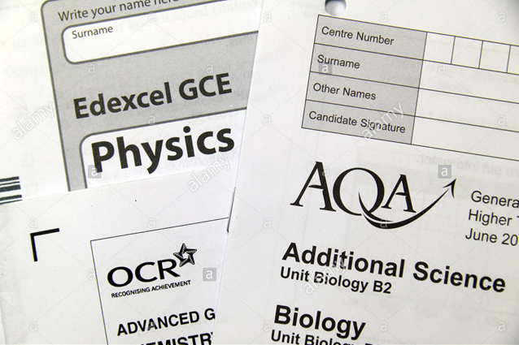
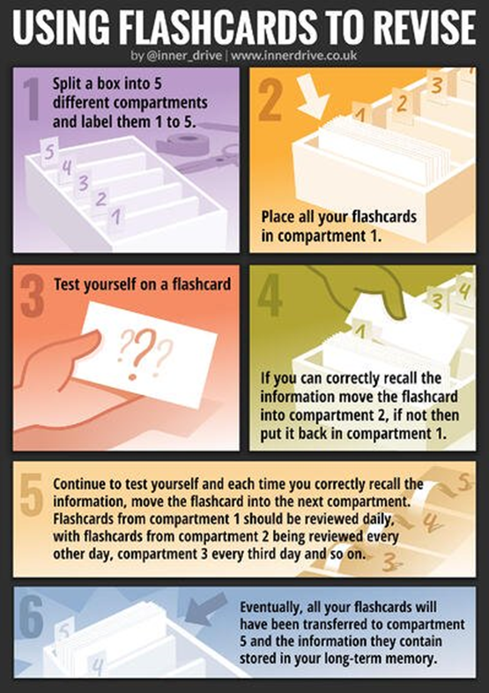
REVISION!
Using flashcards
Completing Past papers
Knowing the subject specification
Creating and using a revision timetable

Slide 40
What are the most challenging parts of year 11 and how did you navigate through them?
The tiredness!!! You need snacks too
There is a lot of exams mocks, mocks, real ones - you can’t go full blast all year. Smash it for the mocks then have a bit of a rest. Then go again in January
The most challenging thing for me is the stress about not getting a 4 in my maths!! I have done loads of extra stuff in school and done all my homework past papers but I just wish I hadn’t left it so late

Slide 41
If you were unsure on what you wanted to do when leaving school, what helped you make your mind up?
Definitely going to the open evenings
Careers talk with miss woodruff really helped me to figure out what I could do
I spoke lots with mum and dad about what a levels I might do, I think I want to go to uni so need to choose a levels that I will get good grades in
I definitely found it easier to focus on my grades when I’d decided where I was going – it gave me a reason to do the work

Slide 42
Rest of year 10
20th June – 4th JulY
Concentrated period with exams in the morning and afternoon
Grades published 16th July

Slide 43
SUBJECT | DECEMBER GRADE | MINIMUM EXPECTED GRADE
BIOLOGY | 5 | 8
CHEMISTRY | 5 | 8
ECONOMICS | 5 | 7
ENGLISH LANGUAGE | 7 | 7
ENGLISH LITERATURE | 6 | 7
FRENCH | 4 | 7
HISTORY | 7 | 8
MATHS | 6 | 8
PHYSICS | 4 | 8

Slide 44
Improvement for Year 11 in 2022
Name | Grades improved since Year 10
ENGLISH
MATHS
EBACC
OPEN
OVERALL

Slide 45
Improvement for Year 11 in 2022
Name | Grades improved since Year 10
ENGLISH | 0.856
MATHS | 1.225
EBACC | 1.346
OPEN | 0.647
OVERALL | 0.942

Slide 46
Improvement in English
Name | Grades improved since Year 10
E W | 4.069
B G | 3.739
T F | 3.664
J L | 3.519
J D | 3.452

Slide 47
Improvement in Maths
Name | Grades improved since Year 10
A M | 3.952
T G | 3.730
D M | 3.162
C W | 2.952
A T | 2.862

Slide 48
Improvement in EBACC
Name | Grades improved since Year 10
C W | 3.582
J L | 3.437
T G | 3.396
A P | 3.178
F H | 2.913

Slide 49
Improvement in Open
Name | Grades improved since Year 10
E W | 3.547
L A | 2.697
T F | 2.297
J L | 2.180
O T | 2.170

Slide 50
Improvement in Year 11Overall
Name | Grades improved since Year 10
E W | 3.095
J L | 2.753
C W | 2.480
M B | 2.241
T G | 2.196
A M | 2.143
M W | 2.128
J C | 2.075
J H | 2.052
O A | 2.005

Slide 51
E W
Subject | End of year 10 | Year 11 results | Difference
English Literature | U
English Language | 4
Maths | 2
Science | 11
Geography | 3
Psycholgy | 1
Drama | 1

Slide 52
E W
Subject | End of year 10 | Year 11 results | Difference
English Literature | U | 7 | 7
English Language | 4 | 5 | 1
Maths | 2 | 5 | 3
Science | 11 | 44 | 3
Geography | 3 | 6 | 3
Psychology | 1 | 5 | 4
Drama | 1 | 4 | 3

Slide 53
Top 10 best progress in Year 11
Name | Progress
Pupil A | 4.028
Pupil B | 3.26
Pupil C | 2.144
Pupil D | 1.787
Pupil E | 1.744
Pupil F | 1.57
Pupil G | 1.52
Pupil H | 1.385
Pupil I | 1.384
Pupil J | 1.256
Average | 2.01

Slide 54
Top 10 best progress in Year 11
Name | Attendance
Pupil A | 99.3%
Pupil B | 100.0%
Pupil C | 99.3%
Pupil D | 98.2%
Pupil E | 97.7%
Pupil F | 95.3%
Pupil G | 97.7%
Pupil H | 99.1%
Pupil I | 97.8%
Pupil J | 96.4%
Average | 98.1%

Slide 55
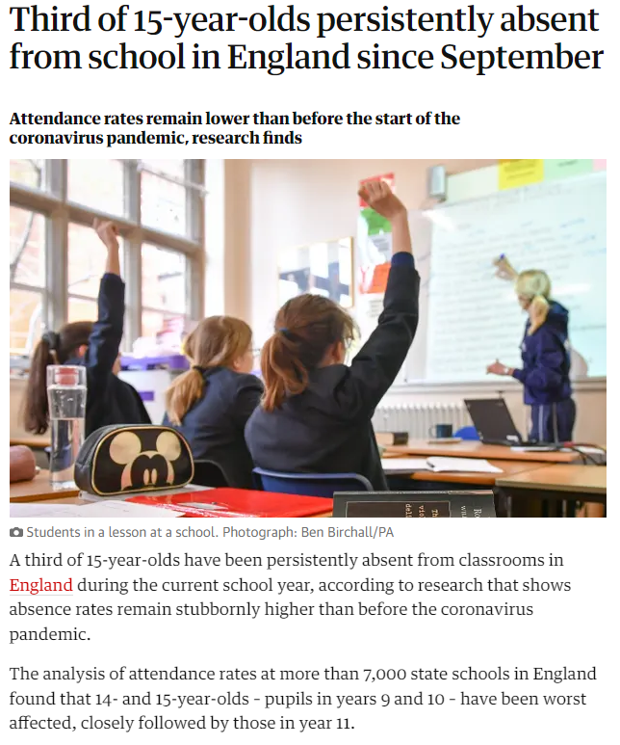

Slide 56
Attendance VS Progress
Year 11 attendance last year | Progress in English | Progress in Maths | Progress in EBACC | Progress in Open | Progress Overall
Above 95% 65 students | 0.3 | 0.27 | 0.73 | 0.17 | 0.38
90% - 95% 41 students | -0.04 | 0.07 | 0.45 | 0.08 | 0.09
85% - 90% 26 students | -0.77 | -0.25 | -0.44 | -0.81 | -0.51
80% - 85% 6 students | -0.79 | -0.84 | -0.73 | -1.42 | -0.97
Under 80% 16 students | -1.84 | -1.73 | -1.88 | -2.27 | -1.93

