Slide 1
Mock Exam timeline

Slide 2
The Exams
Begin Thursday 14th November with German/Spanish Writing exam
Finish Monday 2nd December with German/Spanish reading exam
Individual speaking tests for mfl Tuesday 3rd- Friday 6th December
Exams marked before Christmas
Mock results day Wednesday 18th December

Slide 3
The exams
Maths – 3 exams
English – 2 exams
Science – 3 exams
History – 3 exams
Geography – 2 exams
MFL – 3 exams

Slide 4
The exams
Computer science – 2 exams
Re – 2 exams
DT – 1 exam
Dance – 2 exams
Music – 2 exams
Art/digital art – 1 exam (all day)
It – 1 coursework day (all day)

Slide 5
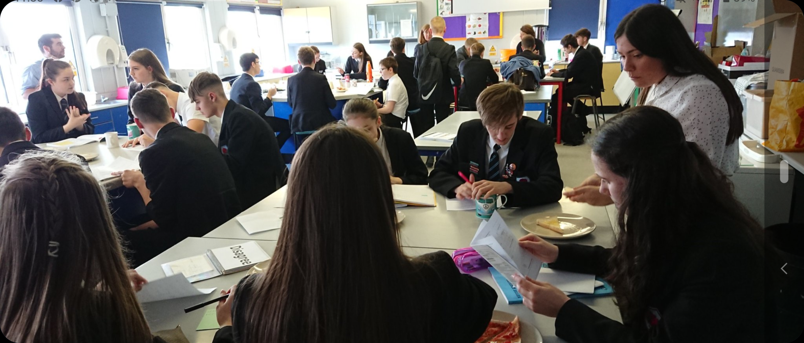
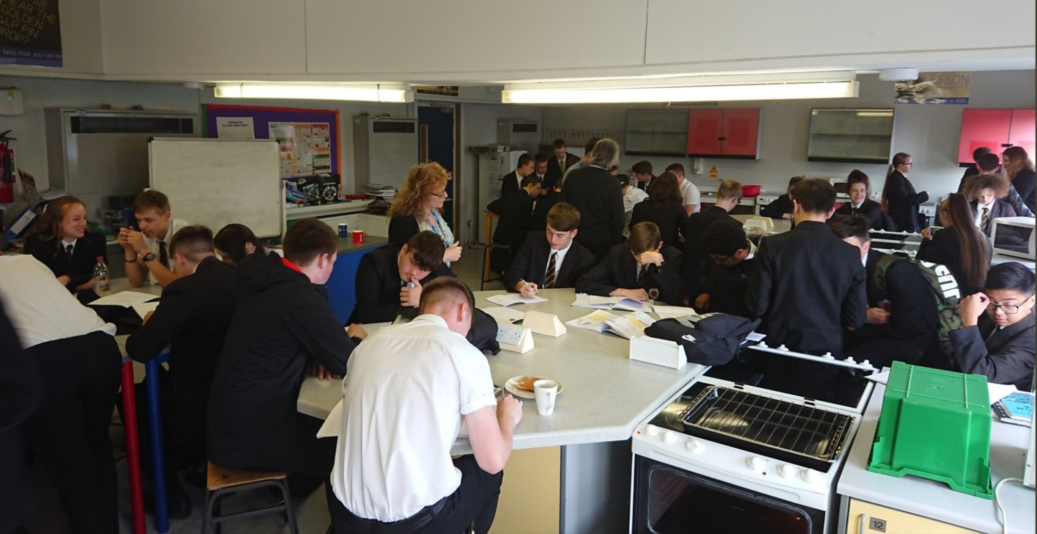
Breakfast revision

Slide 6
eps
From next week eps attendance and learning scores will be distributed in form to students to bring home
To date 885 hours of eps sessions have been completed by year 11 which sounds really positive but if we divide that by the 181 students we have and average of just below 5 sessions for the year.

