Slide 1
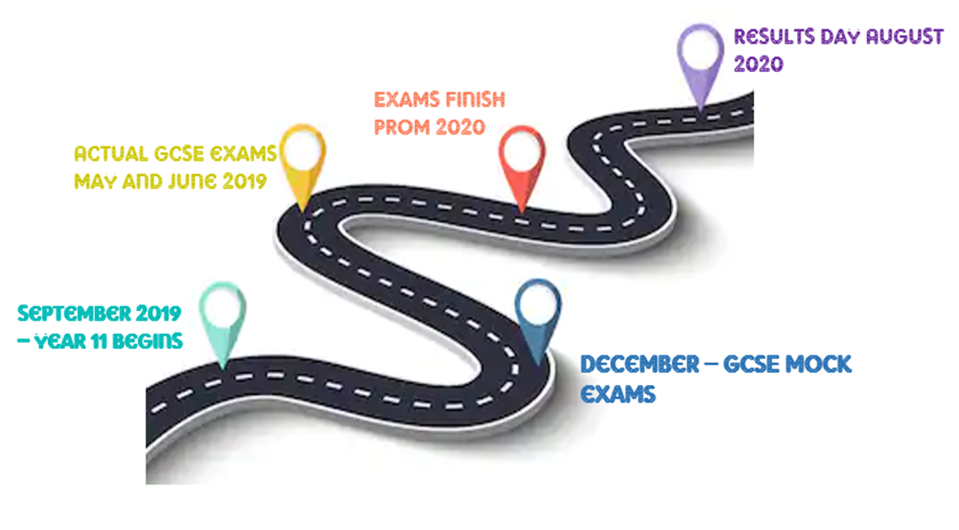
Year 11 – The road ahead

Slide 2
Results
Day
August 20th
Prom 03/07
June
23rd June - GCSE exams finish
Holiday revision classes
timetabled
May
Eps timetable updated from Mock results
6th Jan
Parents evening 21st Jan
11th May - GCSE exams start
Calculator Camp 22nd - 24th May
April
Mar
2nd-6th March
Mocks for English, Maths, Science and Geog/Hist
9th-13th March – MFL speaking
19th Dec – Mock Results Day
Jan
Dec
Nov
Mocks 18th – 29th)
Elevate session 5th Nove – Memory techniques
7th Nov – Elevate parents seminar
Elevate session 19th Sept (Study Sensei)
EPS sessions start Monday 30th – bespoke timetables
Sept

Slide 3
Improvement in Year 11
 | Grades Improved since the end of Year 10
Pupil 1 | 3.383
Pupil 2 | 2.983
Pupil 3 | 2.685
Pupil 4 | 2.682
Pupil 5 | 2.534
Pupil 6 | 2.384
Pupil 7 | 2.384
Pupil 8 | 2.334
Pupil 9 | 2.284
Pupil 10 | 2.184
Pupil 11 | 2.184
Pupil 12 | 2.085
Pupil 13 | 2.084
Pupil 14 | 2.084
Pupil 15 | 2.084

Slide 4
May roberts
Subject | End of year 10 | Year 11 results | Difference
Business Studies | 4
English Language | 4
English Literature | 4
German | 4
History | 3
ICT | 3
LFL CZ | 4
LFL RE | 3
Maths | 5
Science | 10 (55)

Slide 5
May roberts
Subject | End of year 10 | Year 11 results | Difference
Business Studies | 4 | 9 | 5
English Language | 4 | 6 | 2
English Literature | 4 | 6 | 2
German | 4 | 4 | 0
History | 3 | 7 | 4
ICT | 3 | 5.5 | 2.5
LFL CZ | 4 | 8 | 4
LFL RE | 3 | 5 | 2
Maths | 5 | 7 | 2
Science | 10 (55) | 14 (77) | 4

Slide 6
Toby good-marsh
Subject | End of year 10 | Year 11 results | Difference
BTEC Sport | 4
English Language | 2
English Literature | 2
Geography | 4
ICT | 2
LFL RE | 2
Maths | 3
Science | 5 (32)

Slide 7
Toby good-marsh
Subject | End of year 10 | Year 11 results | Difference
BTEC Sport | 4 | 8.5 | 4.5
English Language | 2 | 4 | 2
English Literature | 2 | 4 | 2
Geography | 4 | 4 | 0
ICT | 2 | 2 | 0
LFL RE | 2 | 3 | 1
Maths | 3 | 5 | 2
Science | 5 (32) | 8 (44) | 3

Slide 11
REVISION BEFORE THE MOCKS
2 x 45 minute sessions per evening
3 x 45 minute sessionS on weekend days
These sessions do not include homework but can be used if needed for that purpose
EPS sessions on a mon, wed & thurs
MOCK EXAMS ARE 8 WEEKS AWAY BUT THIS ONLY EQUATES TO 35 SCHOOL DAYS!

Slide 12
REVISION NOTES
Reading your notes or just copying out notes DOES NOT WORK
Any revision you do absolutely must involve you preparing or answering questions
You need to then check that those answers are correct
You need to make a revision timetable to make sure you cover all subjects and still allow yourself to enjoy your free time and hobbies/interests
Colour works!
Mind maps aren’t just for Year 7!
Read the subject specification! Edexcel, AQA, WJEC
Practice, practice, practice! Complete papers but OPEN BOOK & OPEN TIME!

